Slide 1
KINGS_CONTY HOUSE PRICE PREDICTION
BY: JASWINDER_SINGH

Slide 2
DATA
The data for this project belongs to KAGGLE.
Certain columns are dropped before any use
Outliers were present, removed before modeling

Slide 3
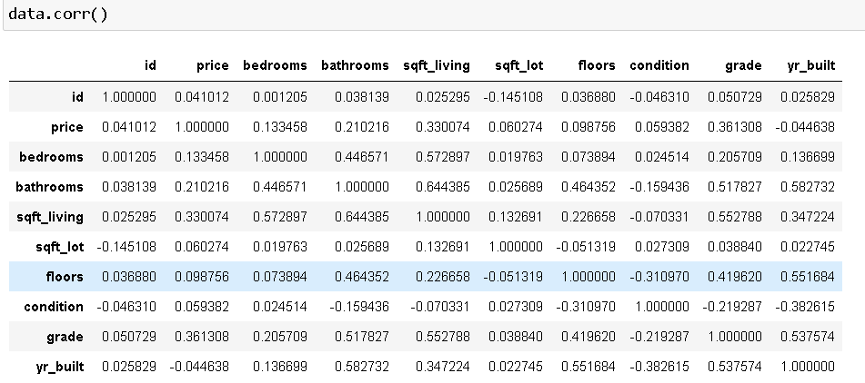
VARIABLES(ATTRIBUTES)

Slide 4
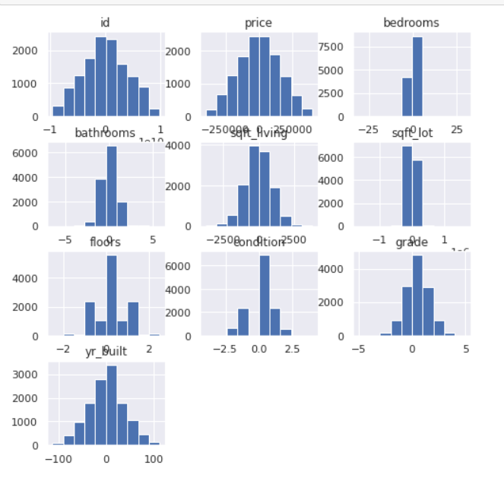
DISTRIBUTION OF THE DATA

Slide 5
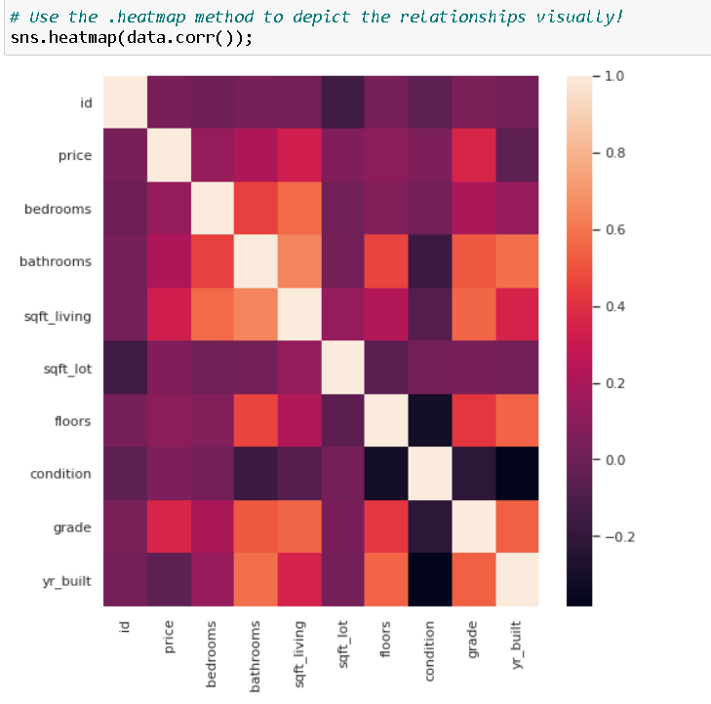
HEATMAP SHOWING THE CORRELATION VISUALLY

Slide 6
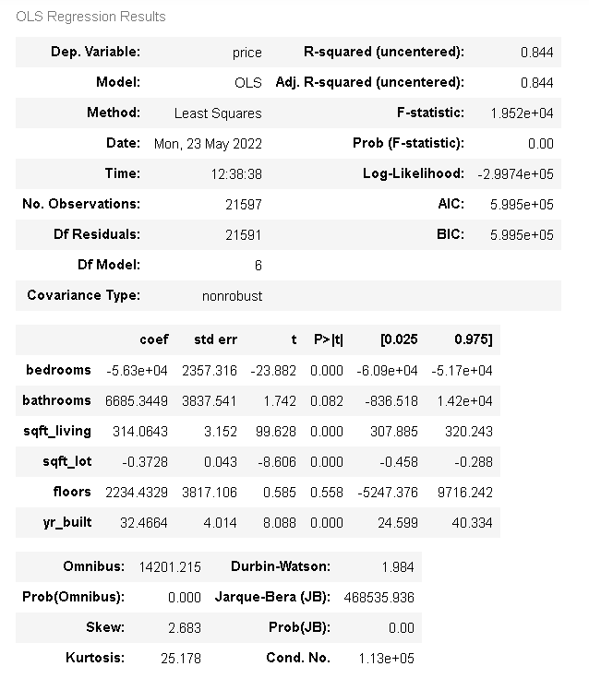
FIRST MODEL SUMMARY
DIFFERENCE IN PREDICTED AND ACTUAL VALUE IS 50K
R2 VALUE IS GOOD BUT NOT SIGNIFICANT
COEFFICIENTS ARE NOT IN DESIRED CONDITON

Slide 7
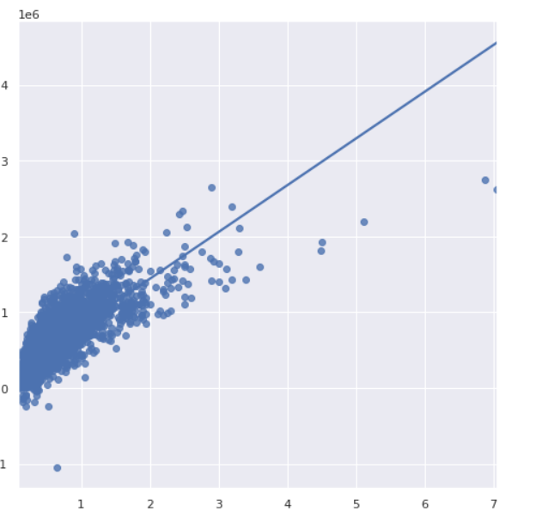
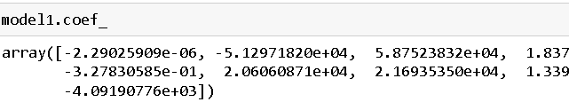
SECOND MODEL(r2_value:0.60)
TRAIN/TEST SPLIT BY RATIO 3:7
THE REGRESSION IS BETTER AND THE POINTS ARE DISTRIBUTED EVENLY
COEFFICINTS ARE BETTER THE PREVIOUS MODELS
POSETIVE REALTION AMONG VARIBALES
R2 VALUE IS GREATER
MODEL SCORE IS DESIRABLE
DIFFERENCE BETWEEN PREDICTED AND ACTUAL VALUE IS ARROUND 30K

Slide 8
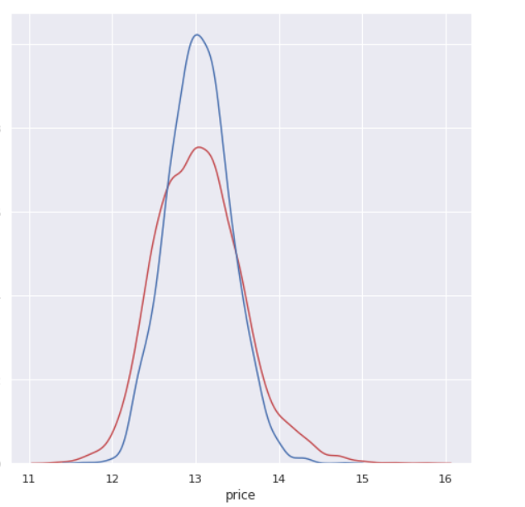
Strong predictors
Bedrooms
Bathrooms
Floors
Area(dimensions)
Condition
Year of formation
The negative coefficients suggesting:
bathrooms and yr_built are inversely proportional
Sq_ft area accross all dimension is positively related to the price
Column | Change/unit | Change in price
Living area | 1.83 | 1000
Floors | 2.06 | 1000
Condition | By 1 | 1000

Slide 9
THANK YOU

